Slide 1


Revised National Development Plan 2018-2027 and its Priority Actions Plan aligned with the Vision “Burundi an Emerging Country by 2040 and a Developed Country by 2060”
PRESIDENCY OF THE REPUBLIC OF BURUNDI

Slide 2
PRESENTATION PLAN
0. Introduction
Issues of the Vision “Burundi an Emerging Country by 2040 and a Developed Country by 2060”
Vision Pillars and Objectives
Vision Indicators and targets
Strategic axes of the revised NDP in line with the 5 pillars of the vision
Conceptual diagram of the revised Burundi NDP and its PAP 2023-2027
Structure of Priority Action Plan : Five-year budget by Pillar of the Vision in billions of BIF;
Structure of Priority Action Plan : Five-year budget by priority program (aligned with the vision) in billions of BIF;
Structure of the Priority Action Plan: Five-year budget by axis of the revised NDP in billions of BIF;
Takeaway message

Slide 3
0.INTRODUCTION
The Vision Burundi an ‘’Emerging Country document by 2040 and a developed country by 2060’’was approved by the Government in August 2023.
" By 2040, Burundi will be a peaceful country, where everyone lives in decent conditions, where no one dies from an avoidable cause, with a competitive economy driven by the agri-food and high value-added industrial sectors and through mining for the benefit of the society ; all in a preserved natural environment and with consideration of gender and equity.
Development of vision operationalization tools.
National Development Plan (NDP) and its Priority Action Plan 2023-2027
Sectoral policies and strategies.

Slide 4
I. ISSUES OF BURUNDI VISION AN EMERGING COUNTRY BY 2040 AND DEVELOPED COUNTRY BY 2060
2. A structural transformation of the economy to accelerate economic growth without damaging ecological balance
3. Evidence-based decision-making and a results/program-based management and financing approach
1. Improving living conditions and quality of life for the populqtion, with sustanaible and controlled demographic growth

Slide 5
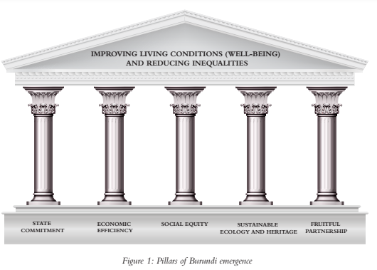
II. VISION PILLARS AND OBJECTIVES
II.1. Pillars

Slide 6
II. VISION PILLARS AND OBJECTIVES (cont’d)
1.
Improving the institutional capacity of the State
2.
Strengthening the political commitment of the State
Pillar No. 1:
State commitment
II.2. Vision Objectives

Slide 7
II. VISION PILLARS AND OBJECTIVES (cont’d)
II.2. Vision Objectives
3. Developing agriculture that creates wealth and catalyzes food security
4. Increasing production and improving access to energy
5. Improving logistics infrastructure and accessibility of all areas
6. Cleaning up and stabilizing the macroeconomic framework
7. Developing the industrial sector and its competitiveness
8. Developing the financial services sector and new information and communication technologies (NICT)
9. Strengthening the service sector
10. Gradually reducing aid dependency
Pillar No.2:
Economic Efficiency

Slide 8
II. VISION PILLARS AND OBJECTIVES (cont’d)
II.2. Vision Objectives
11. Empowering young people through self-creation of jobs
12. Improving access to basic healthcare for all
13. Developing cutting-edge hospital services
14. Developing quality and inclusive basic education
15. Setting up post-basic vocational training adapted to the needs of emerging countries
16. Developing a competitive higher education in science and technology and contributing to the development of Burundi
17. Ensuring social protection for all
18. Improving access to drinking water, hygiene and sanitation.
19. Intensifying urbanization and the promotion of decent housing
Pillar No. 3:
SOCIAL EQUITY

Slide 9

II. VISION PILLARS AND OBJECTIVES (cont’d)
II.2. Vision Objectives
20.
Protecting the environment and strengthening resilience to climate change
21.
Safeguarding and promoting cultural and natural heritage
Pillar No. 4:
Sustainable Ecology and Heritage

Slide 10
II. VISION PILLARS AND OBJECTIVES (cont’d)
II.2. Vision Objectives
22.
Mobilizing Partnership for Development (PAD) and diaspora
Pillar No. 5:
Fruitful partnership

Slide 11
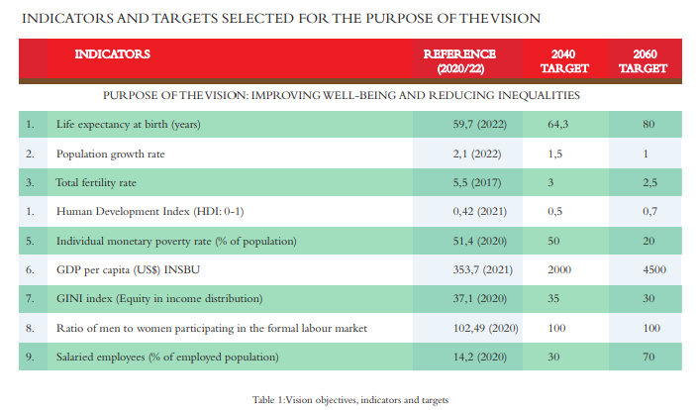
III. INDICATORS AND TARGETS OF THE VISION

Slide 12
IV. STRATEGIC AXES OF THE REVISED PND IN LINE WITH THE 5 PILLARS OF THE VISION
Axis 1: Structural transformation for a sustainable and digital economy whose strategic objective is to promote sectors that drive sustainable growth and create jobs;
Axis 2. Development of human capital and social inclusion with the strategic objective of improving the supply of and access to basic social services;
Axis 3. Environment and cultural and natural heritage aimed at protecting ecology and heritage;

Slide 13
IV. STRATEGIC AXES OF THE REVISED NDP IN LINE WITH THE 5 PILLARS OF THE VISION
Axis 4. Cooperation and mobilization of resources which has the strategic objective of developing international cooperation for efficient mobilization of resources;
Axis 5. Governance, peace, reconciliation with the purpose of ensuring good governance and social cohesion.

Slide 14
V. CONCEPTUAL DIAGRAM OF THE REVISED BURUNDI NDP AND ITS PAP 2023-2027
5 strategic axes
18 priority programs
69 project ideas
9 impact indicators and 100 effect indicators defined in this vision are integrated into the PAP 2023-2027 with the aim of gradually assessing the state of implementation of the revised Burundi NDP for the period 2023-2027.
The total amount during the 5 years of the NDP implementation is about 28.5 trillion USD : available: 4.53 trillion USD (Gvt:1.84 and partner: 2.69)
Gap : 24.03 trillion USD

Slide 15
VI. STRUCTURE OF THE PRIORITY ACTION PLAN: FIVE-YEAR BUDGET BY PILLAR OF THE VISION IN BILLIONS OF BIF

Slide 16
BUDGET OF REVISED NDP BY YEAR IN BILLIONS OF BIF

Slide 17
VII. STRUCTURE OF THE PRIORITY ACTION PLAN: FIVE-YEAR BUDGET BY PRIORITY PROGRAM (ALIGNED WITH THE VISION) IN BILLIONS OF BIF

Slide 18
VII. STRUCTURE OF THE PRIORITY ACTION PLAN: FIVE-YEAR BUDGET BY AXIS OF THE REVISED NDP IN BILLIONS OF BIF

Slide 19
VIII. TAKEAWAY MESSAGE
Burundi is a country full of opportunities for investment (details in the next presentation);
Investors are welcome for these opportunities;
Burundi is committed to strengthening good governance on all institutional and administrative dimensions, subsequently allowing better supervision of growth-promoting sectors with a view to ensuring the right path towards achieving the emergence projected for 2040 through the structural transformation of the economy towed by the private sector.
For more details on projects and programs, see the website
https://vision-burundi.gov.bi/Acceuil/table_ronde

Slide 20
Thank you for your attention !

